Slide 1
Java Class
Day 3

Slide 2





Jul
Aug
Big Data Analyst(10/1)
ADsP(8.28) 8/1~8/5
8/29~9/2
TOEIC(7/24) 6/6~7/11
TOEIC(8/07) 6/20~7/25
TEPS(7/16) 6/29~7/12
TEPS (8/06) 6/20~7/17
TOEIC(8/21) 7/ 4 ~ 8/ 8
TEPS (8/20) 7/ 4 ~7/31
www.toeic.co.kr
www.teps.or.kr
www.dataq.or.kr
austin.sogang.ac.kr
austiny.snu.ac.kr

Slide 3
Mon
Tue
Wed
Thu
1. Main
2. Main
3. Main
4. Main
LUNCH
5. Sub
6. Sub
7. Sub
8. Recap, Test
Fri
1. Recap Sub
2.
3.
4.
LUNCH
5. Recap Main
6.
7.
8. Test
Jul
Java Basic
Aug
Java Intermediate
Database
HTML, CSS, JS

Slide 4
Java
4 Data Type & Operator
4.1 Data Type
4.1.1 Basic - Logical, Character, Integer, Double
4.1.2 Advance - Casting
4.2 Operator
4.2.1 Basic – Operators
4.2.2 Advance - Assignment / Arithmetic / Comparison / Logical
4.3 Exam
5 Control Statement
5.1 If
5.1.1 Basic - If ~ Else
5.1.2 Advance - Continue, Break
5.2 Switch
5.2.1 Basic
5.2.2 Advance
5.3 Exam

Slide 5
Java
6 Loops
6.1 for
6.1.1 Basic
6.1.2 Advance
6.2 enhanced for (for each)
6.2.1 Basic
6.2.2 Advance
6.3 Exam

Slide 6
HTML
1 HTML Basic
1.1 HTML Tag
1.2 HTML Entity
2 Text
2.1 Text
2.2 Style

Slide 7


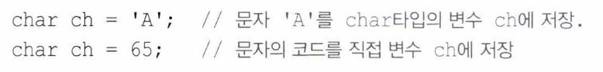
4 Data Type & Operator 4.1 Data Type

Slide 8
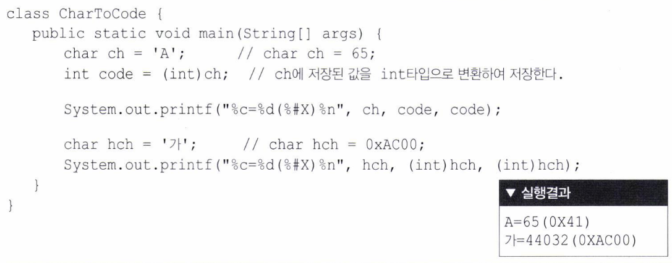

Slide 9

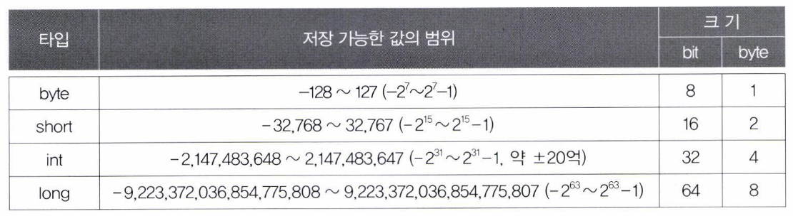

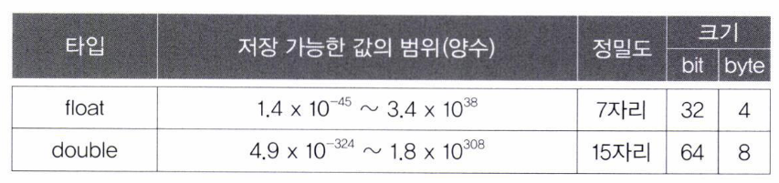

Slide 10
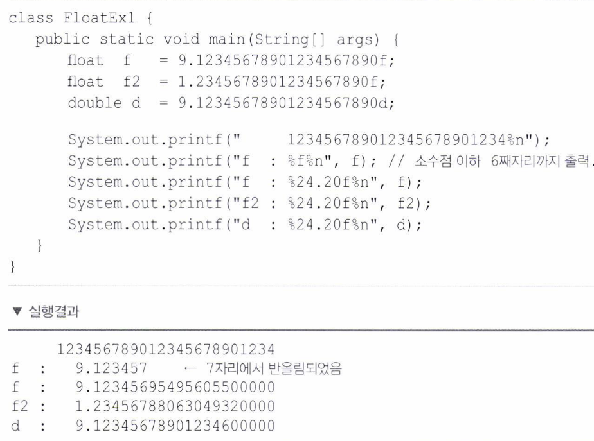

Slide 11

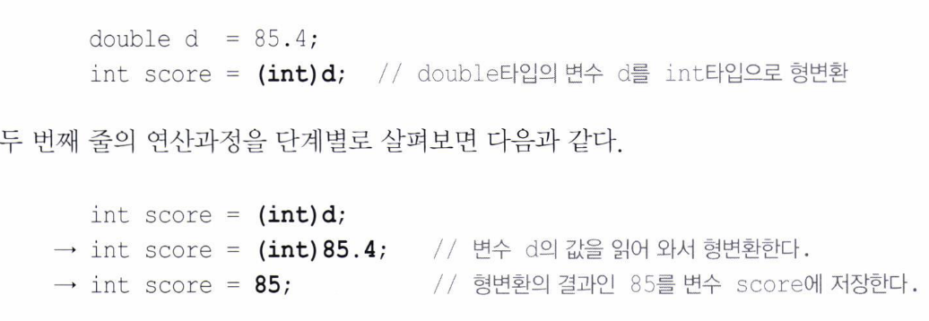

Slide 12
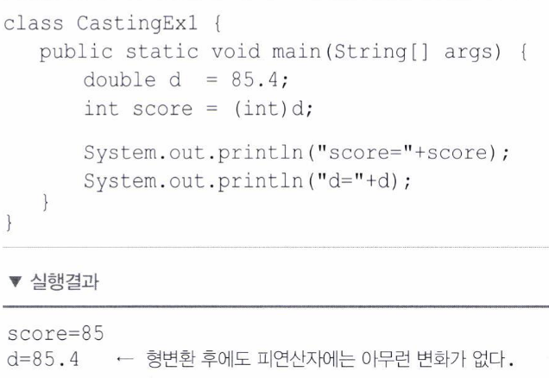

Slide 13
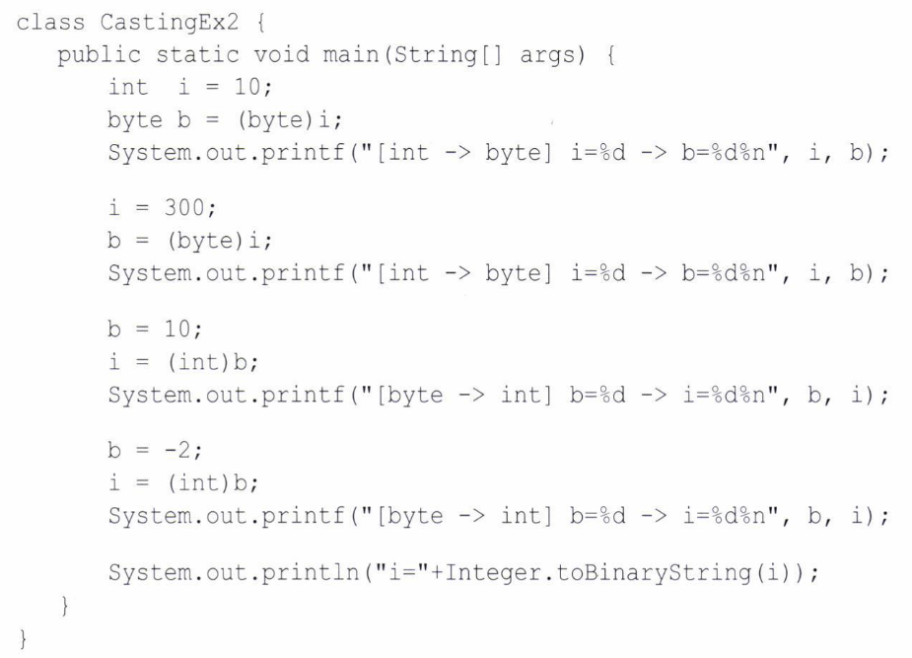
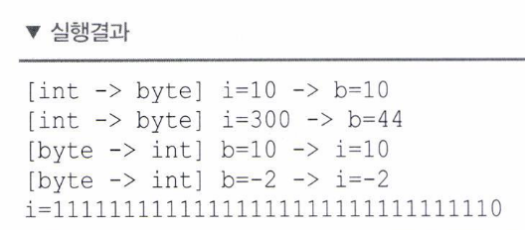

Slide 14
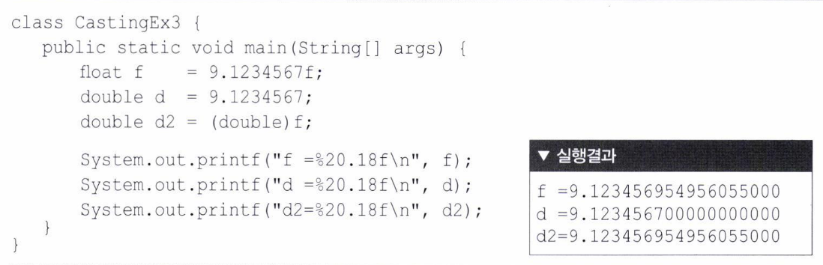

Slide 15
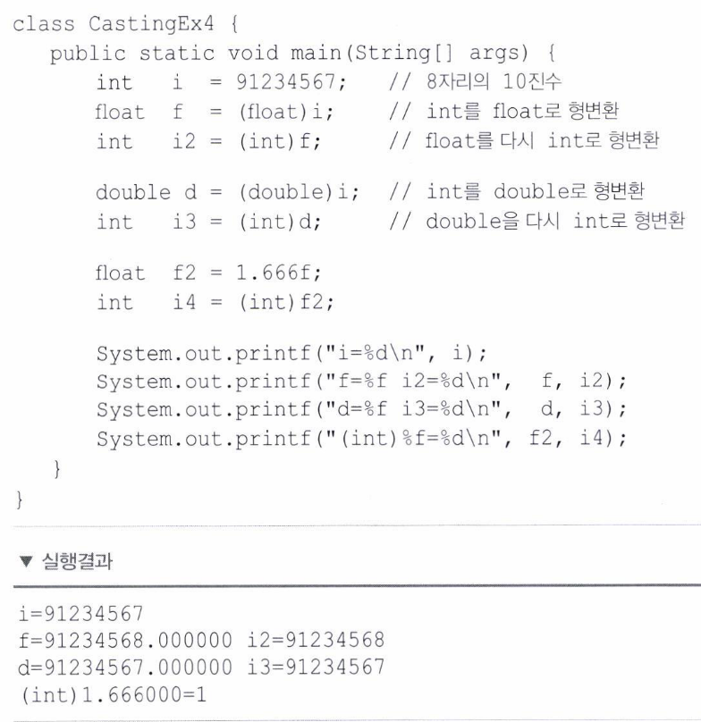

Slide 16
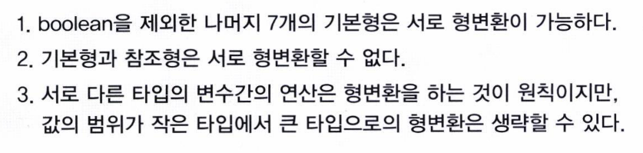


Slide 17
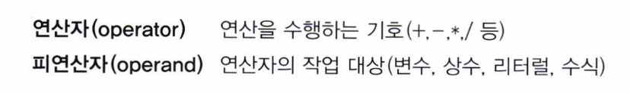
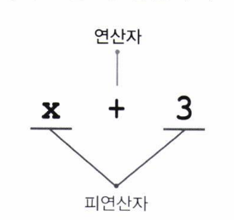
4 Data Type & Operator 4.2 Operator

Slide 18
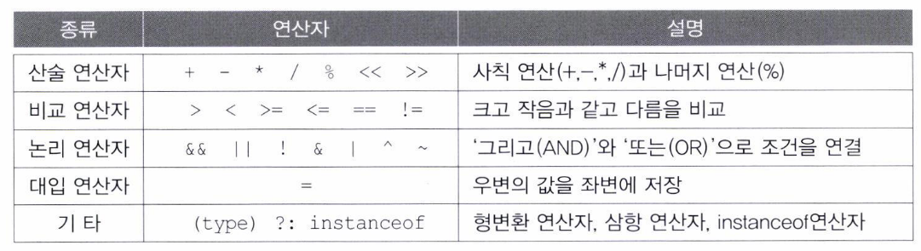

Slide 19

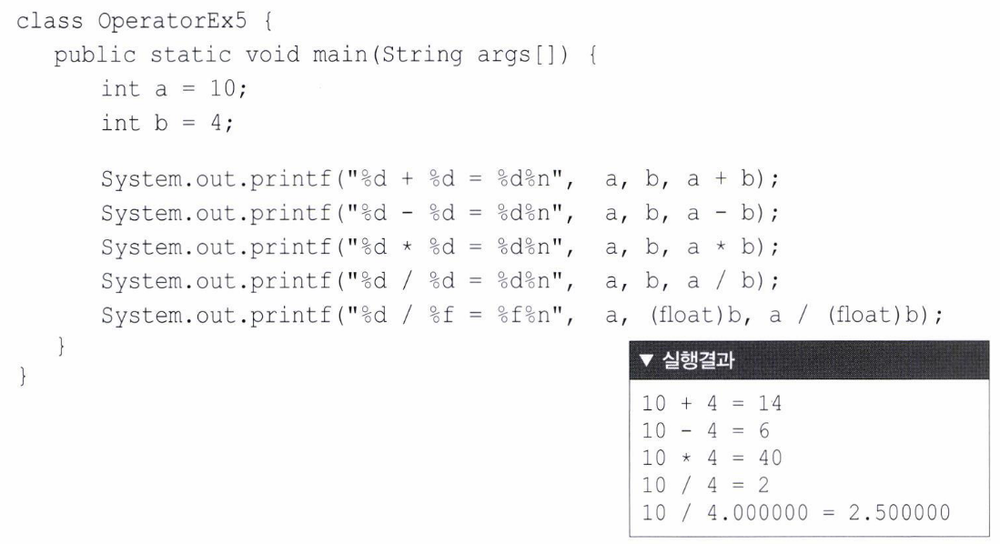

Slide 20

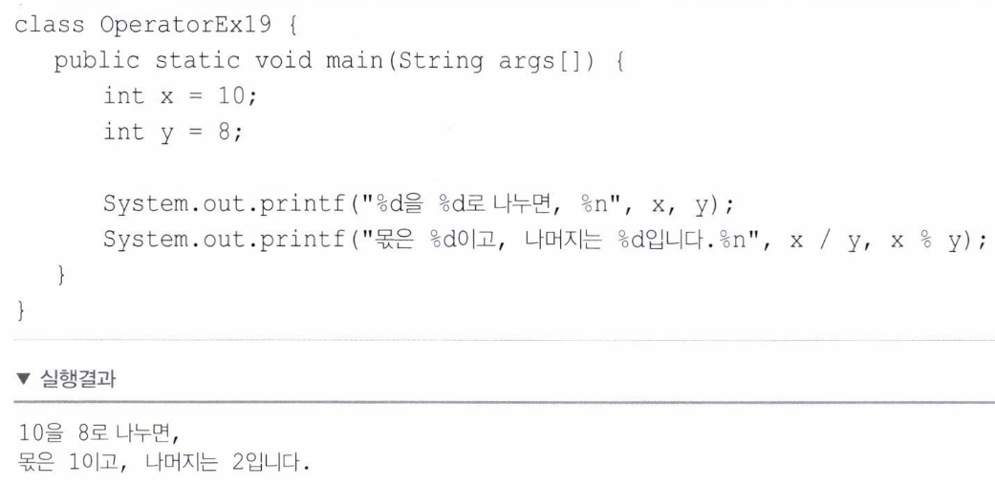

Slide 21

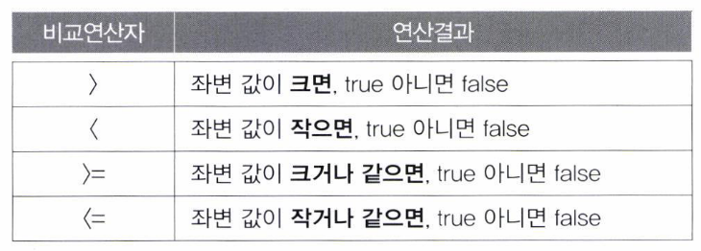
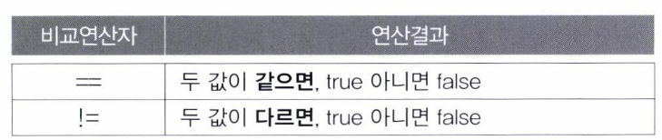
<>

Slide 22
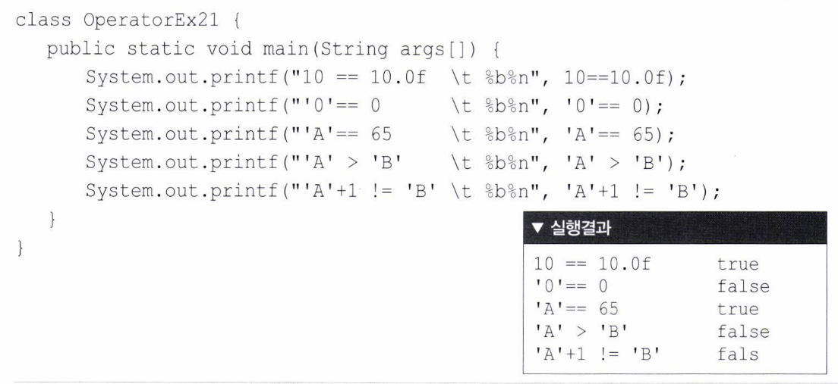

Slide 23
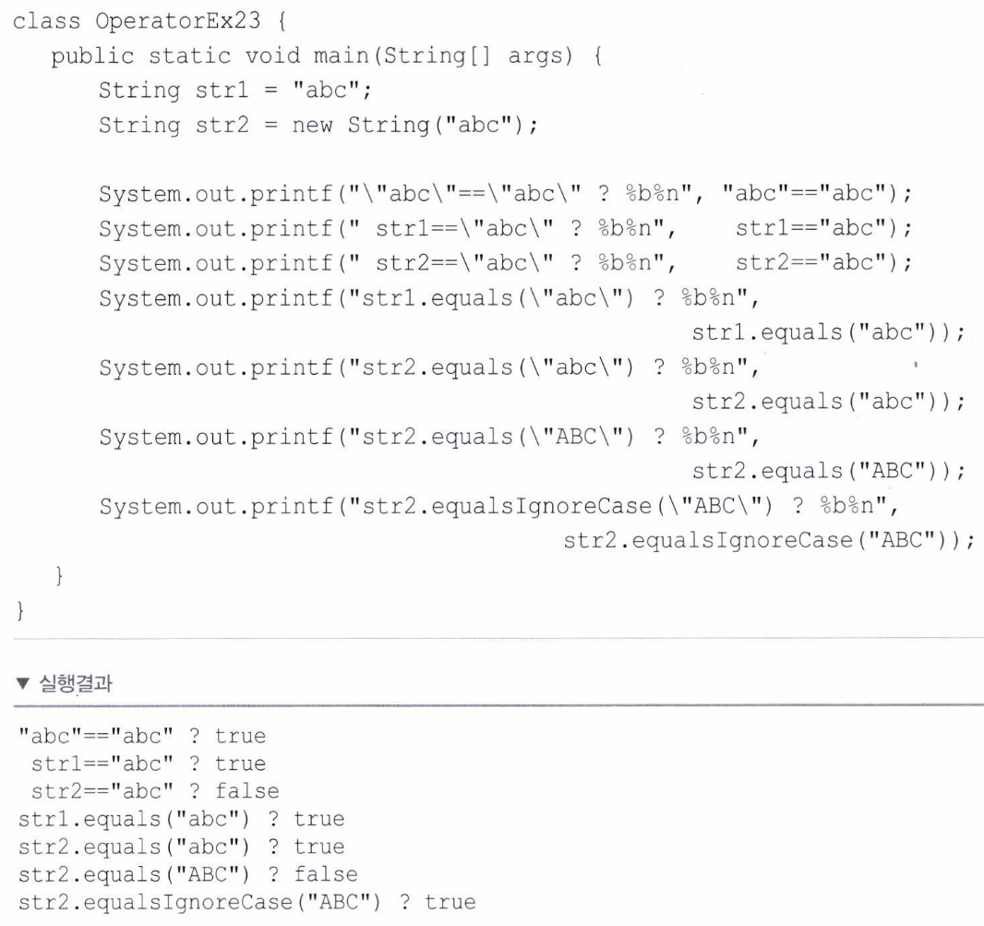

Slide 24

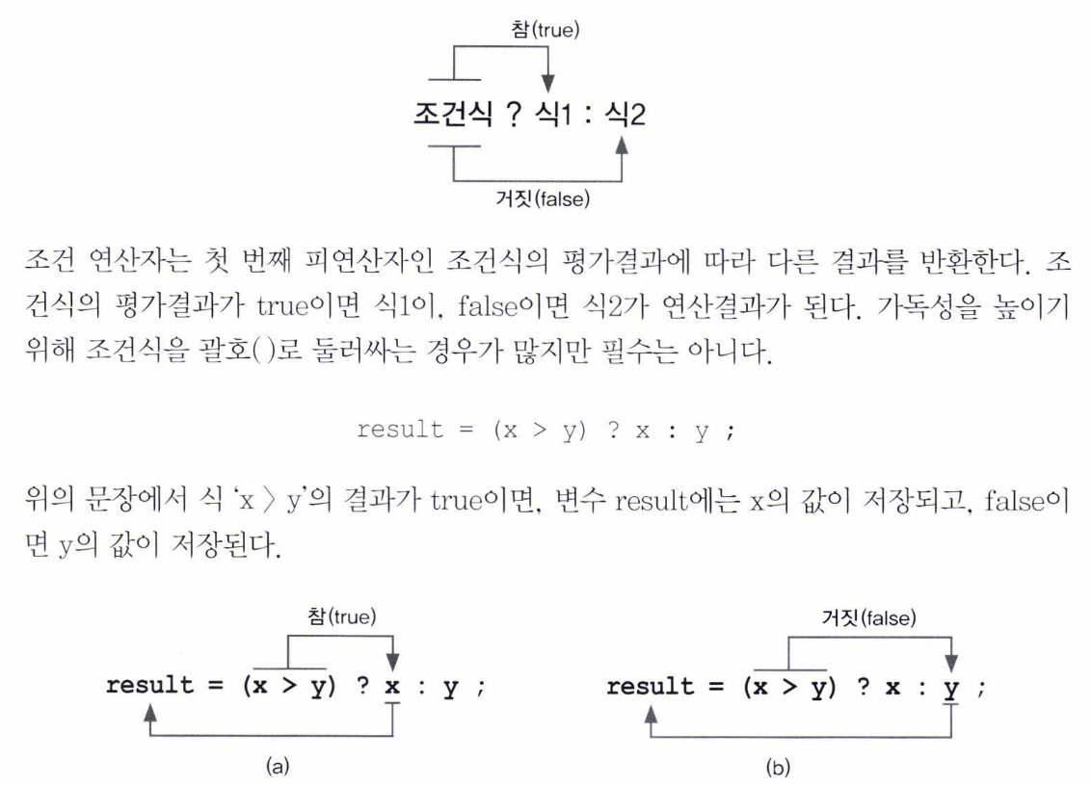

Slide 25
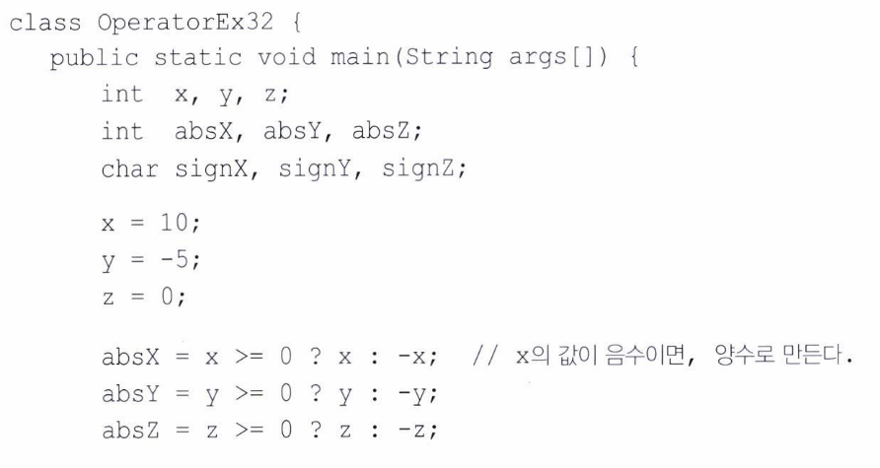
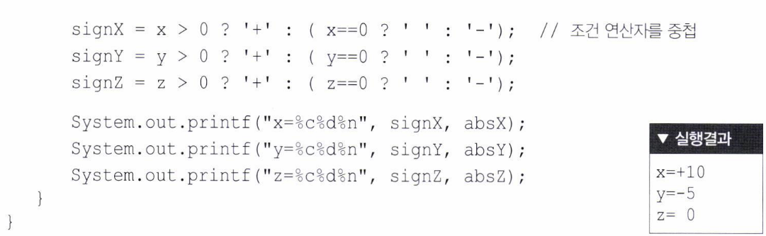

Slide 26
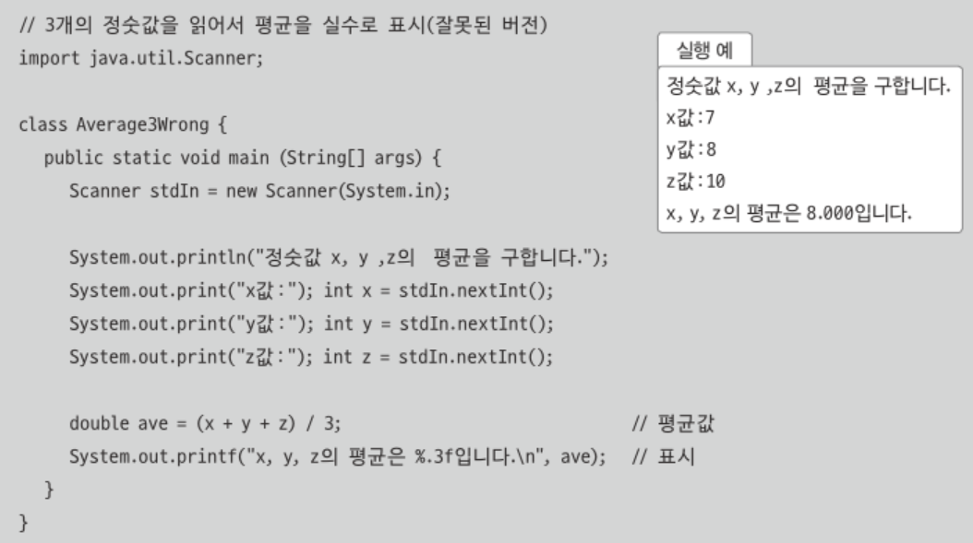
4 Data Type & Operator 4.3 Exam

Slide 27
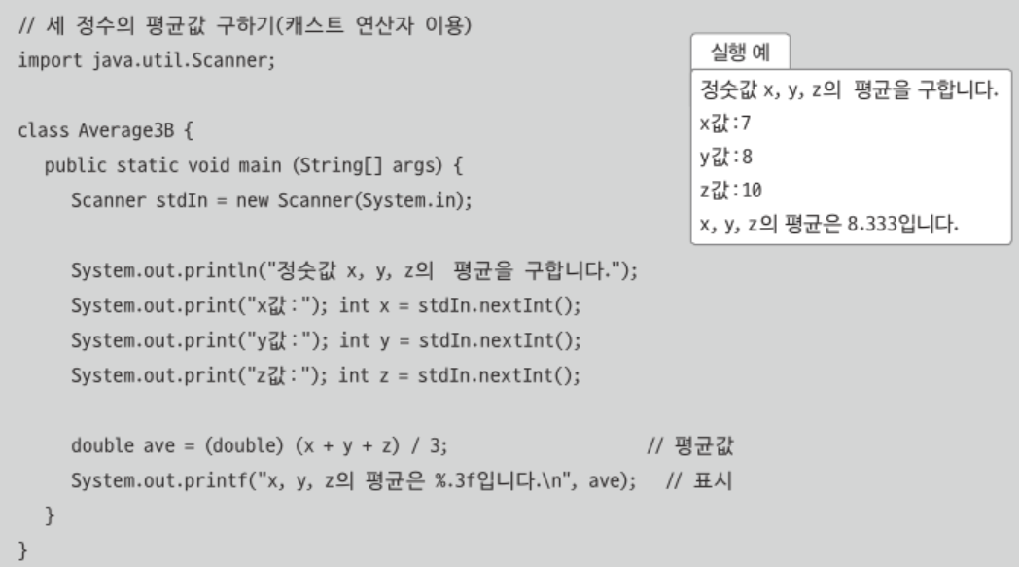

Slide 28
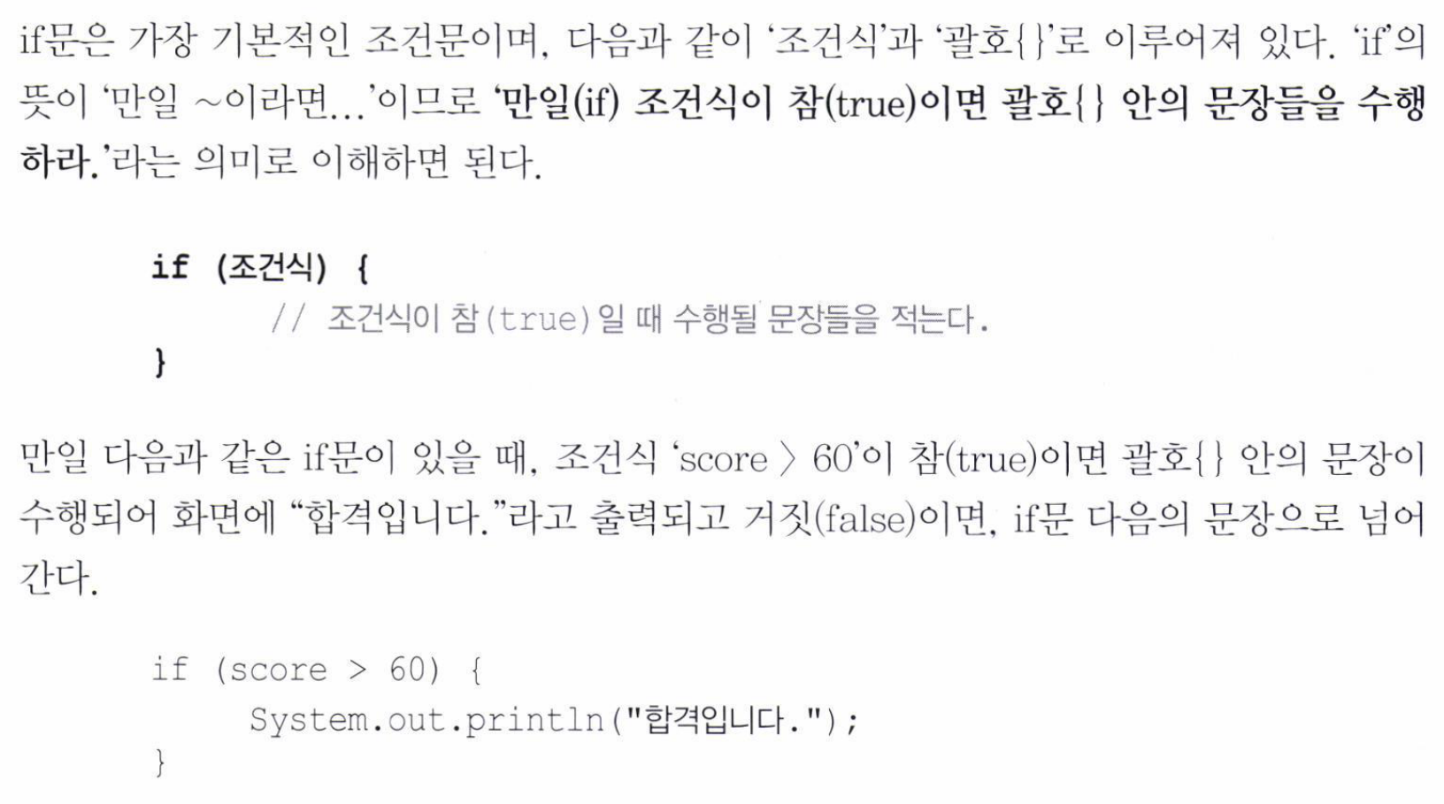
5 Control Statement 5.1 If

Slide 29
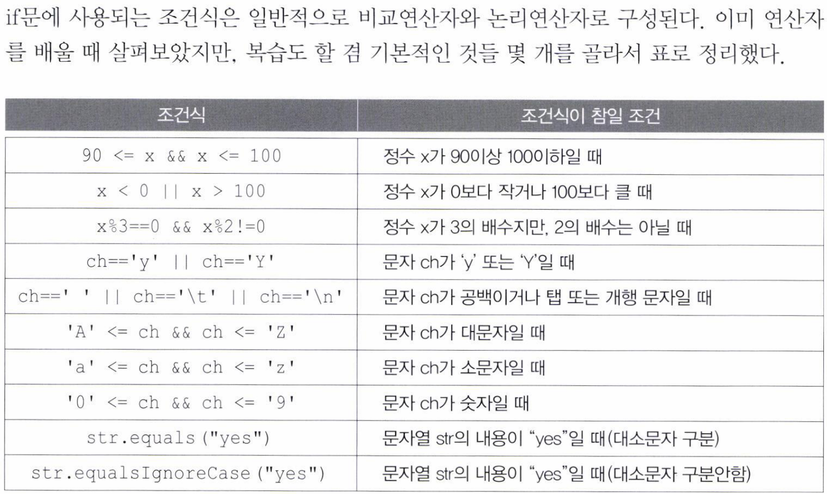

Slide 30
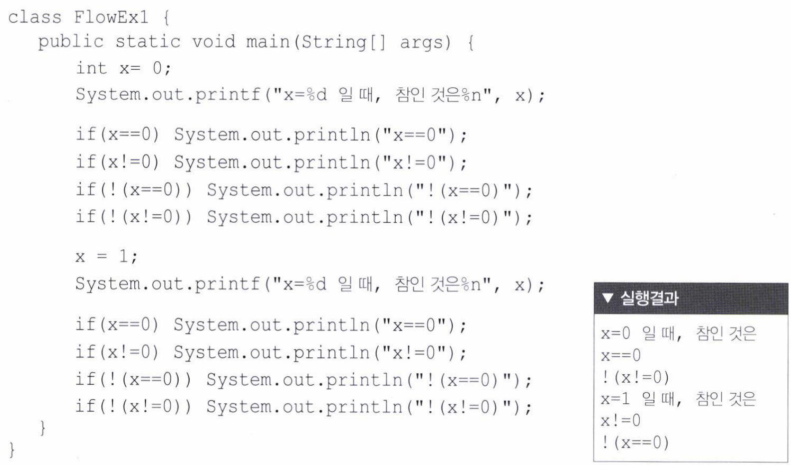

Slide 31
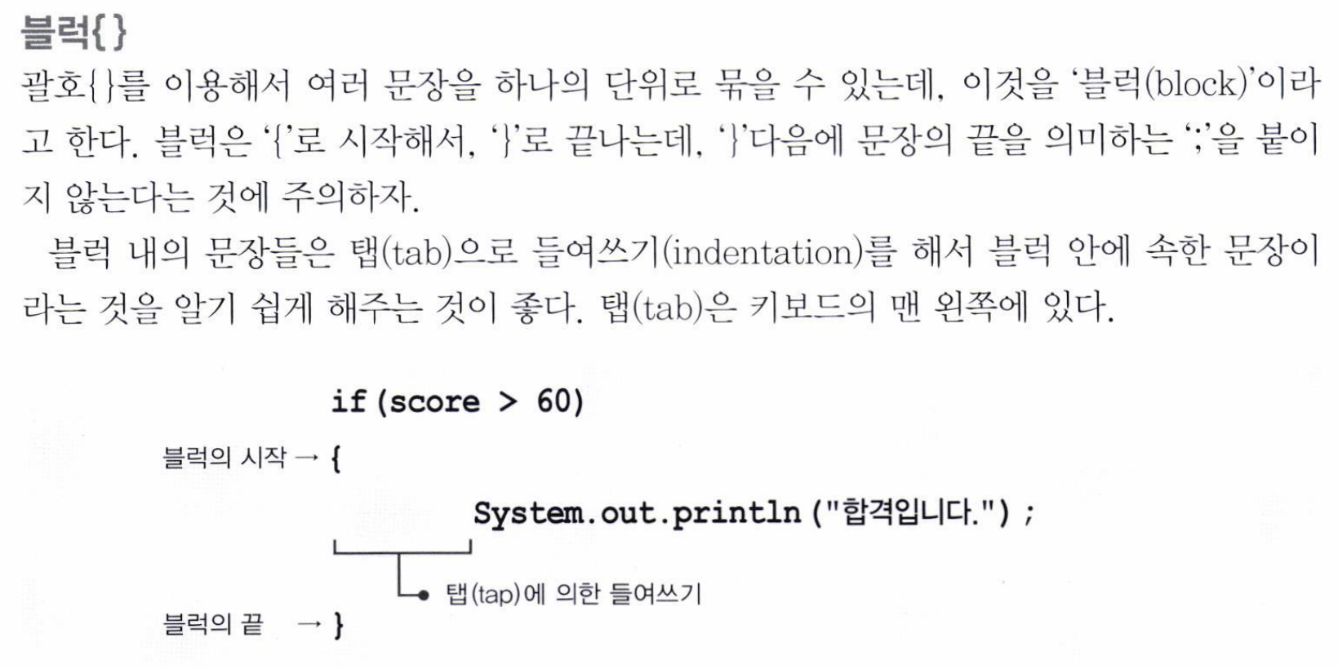

Slide 32
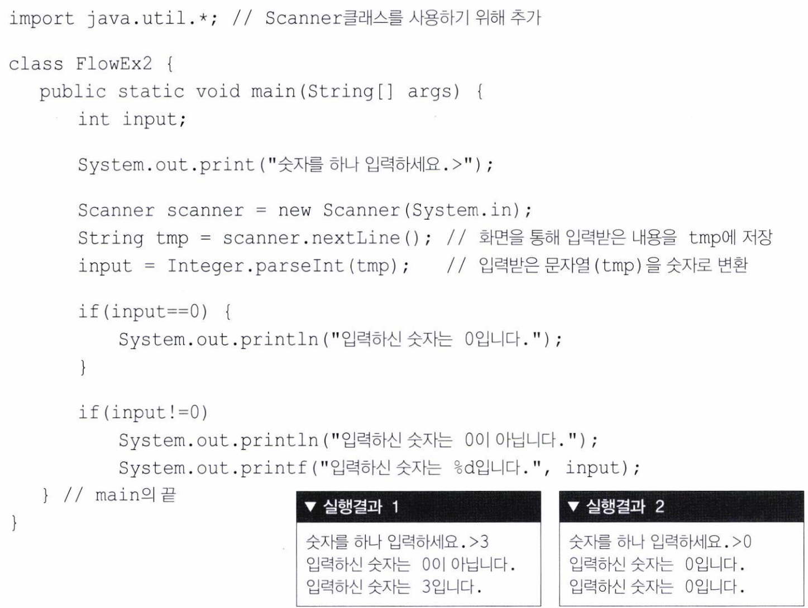

Slide 33
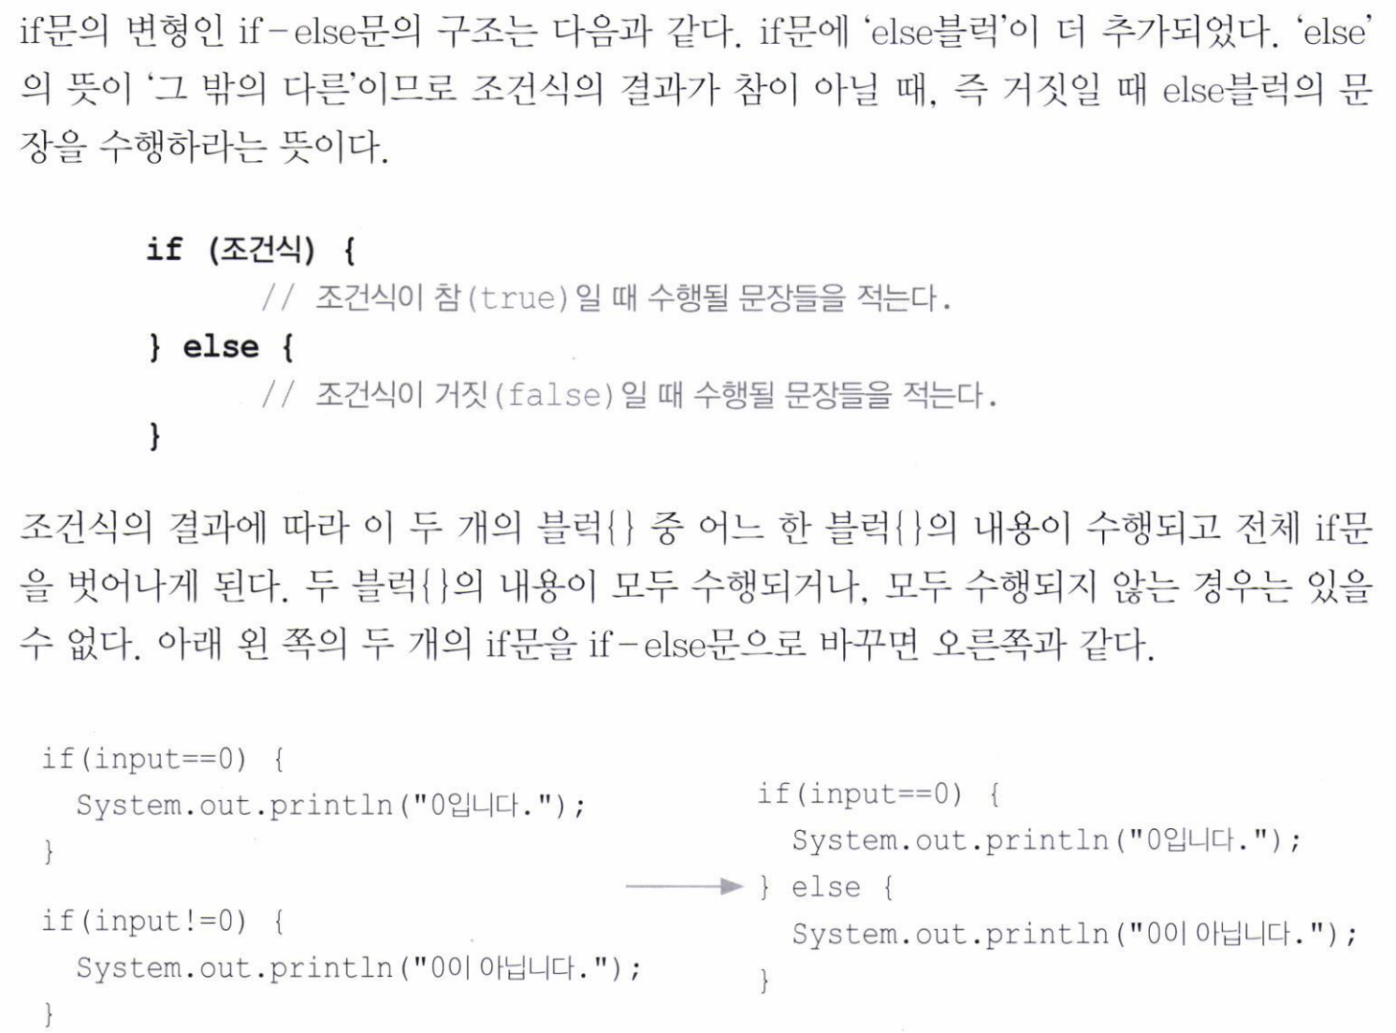

Slide 34
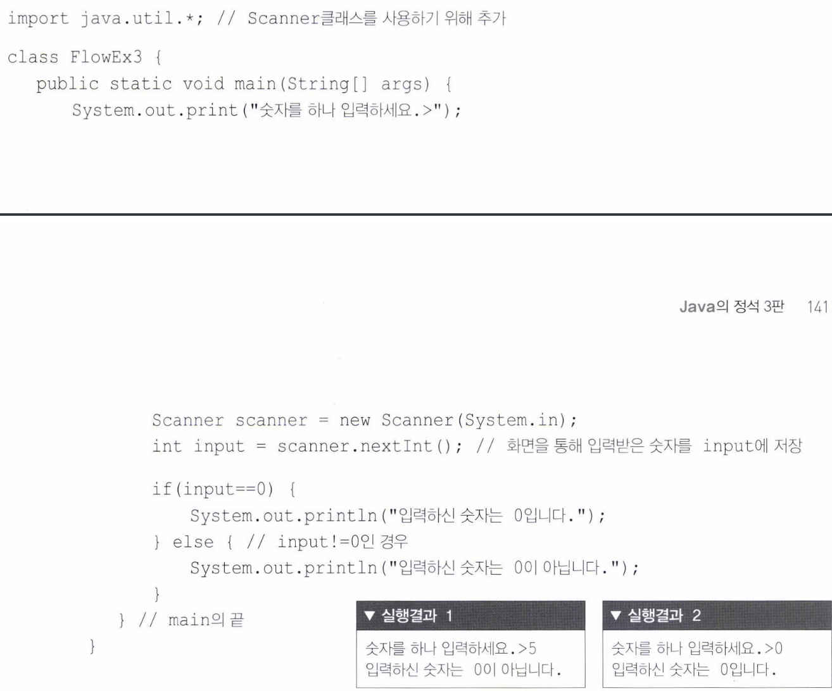

Slide 35
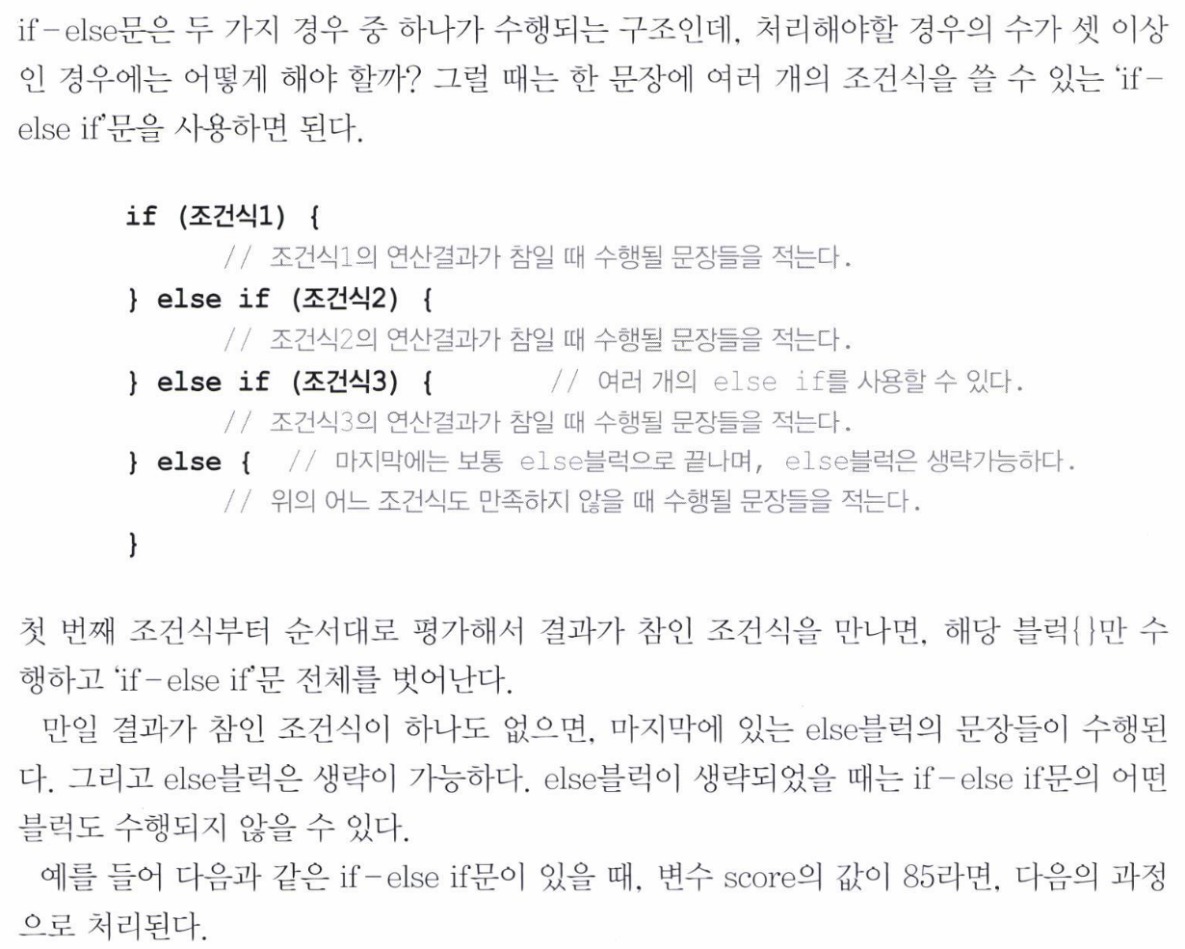
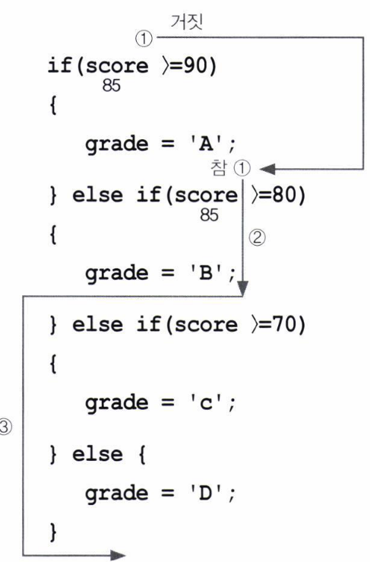

Slide 36
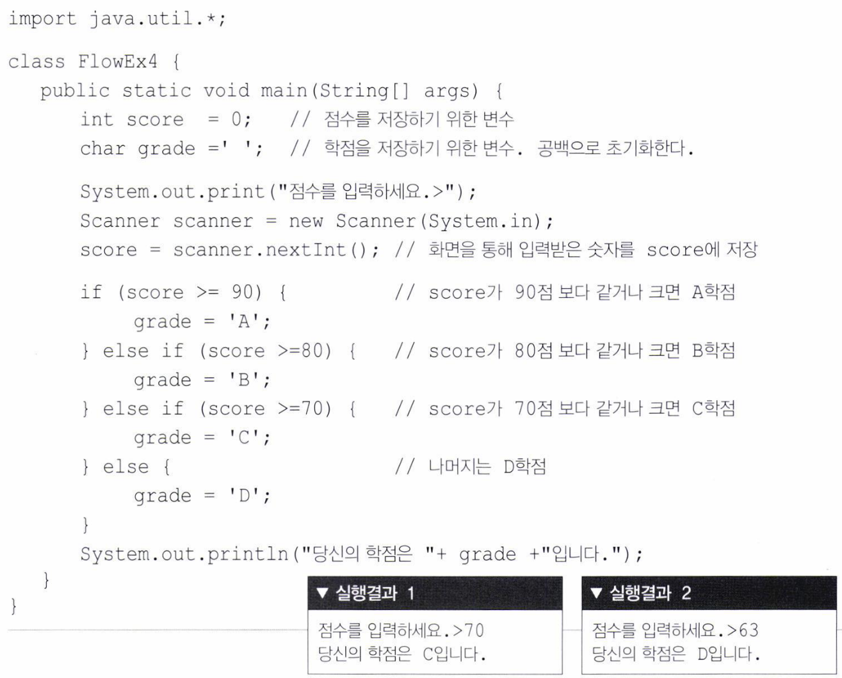

Slide 37
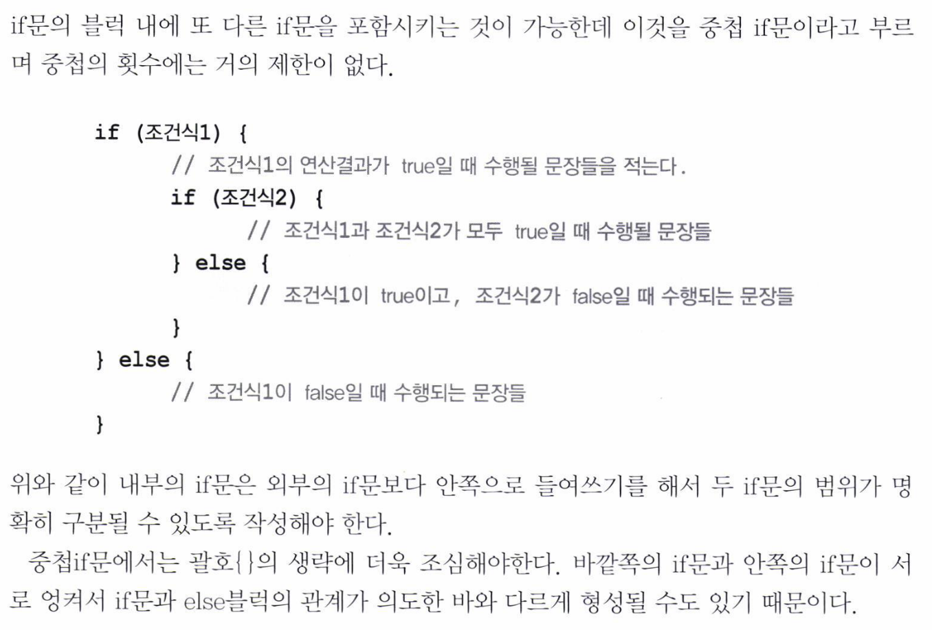

Slide 38
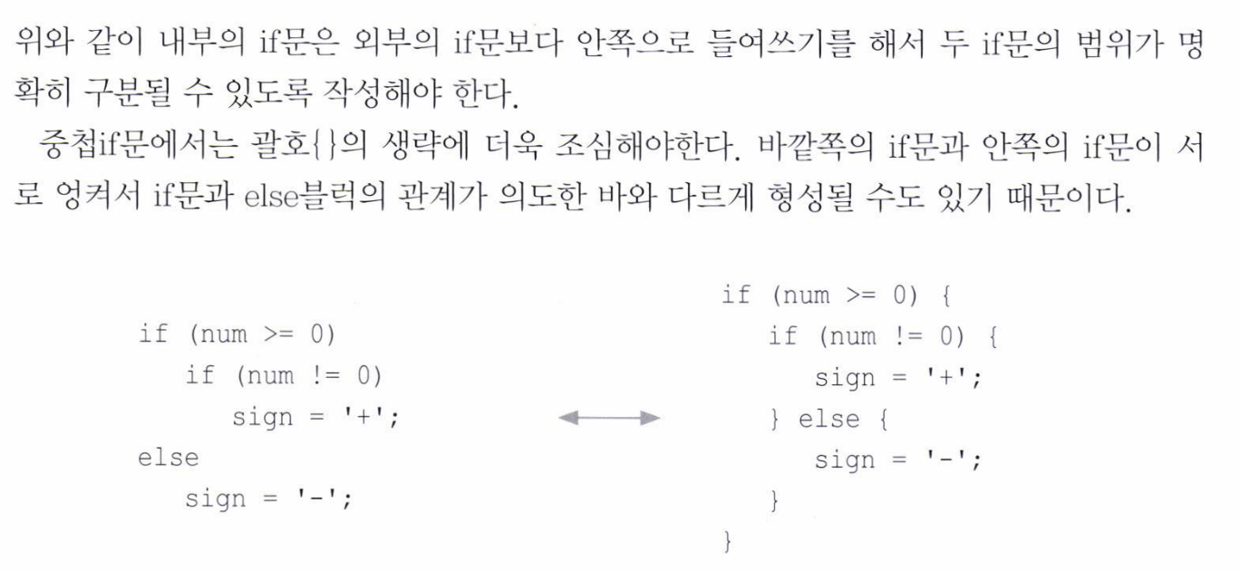

Slide 39
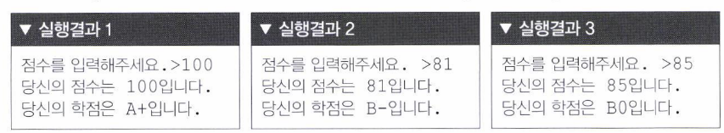

Slide 40
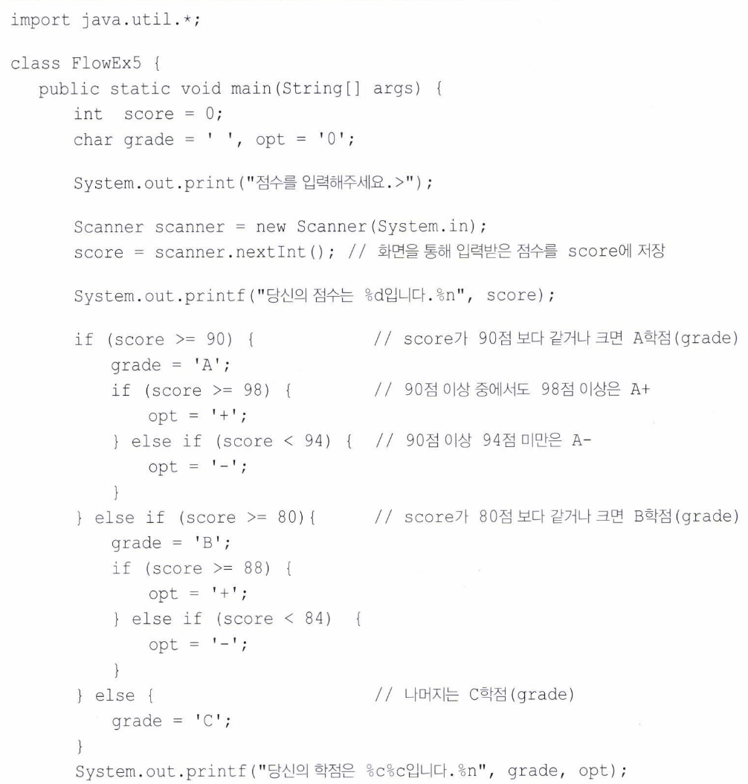

Slide 42
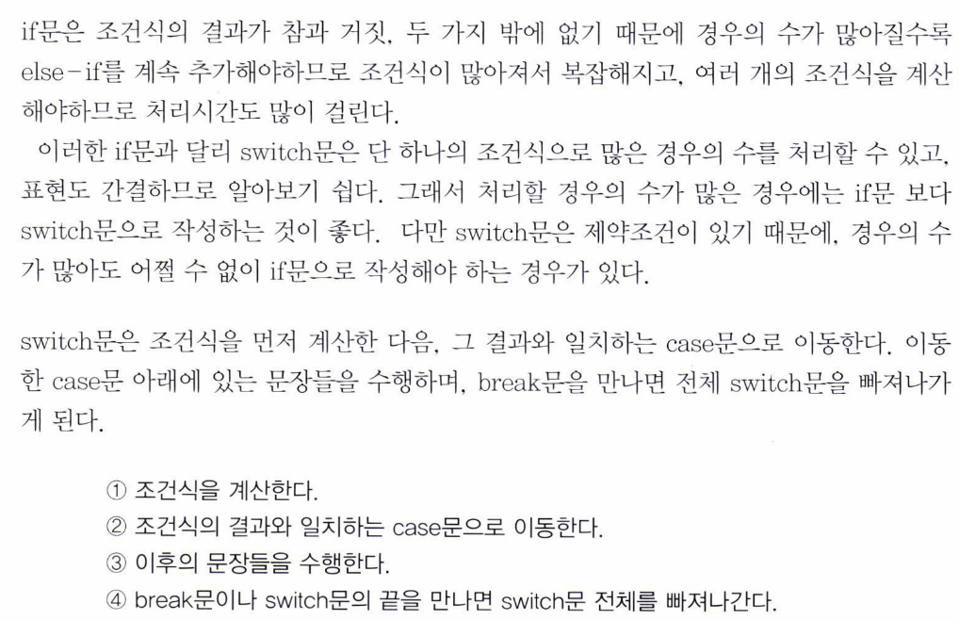

Slide 43
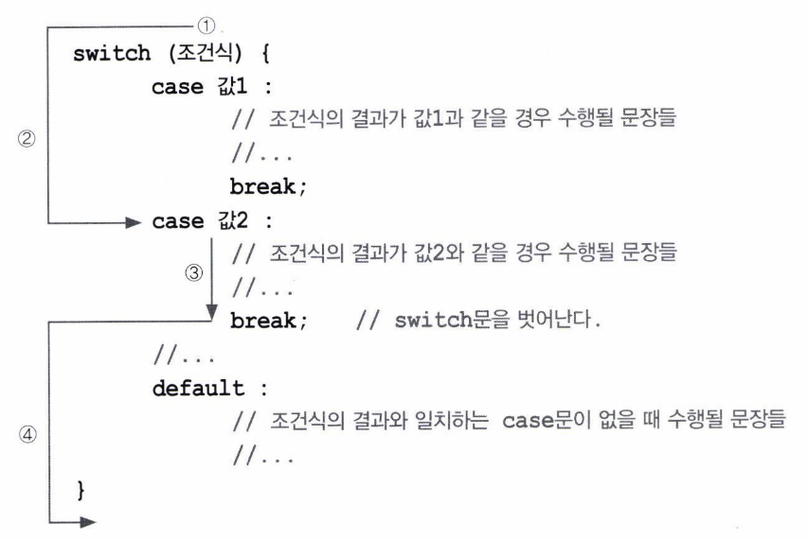

Slide 44
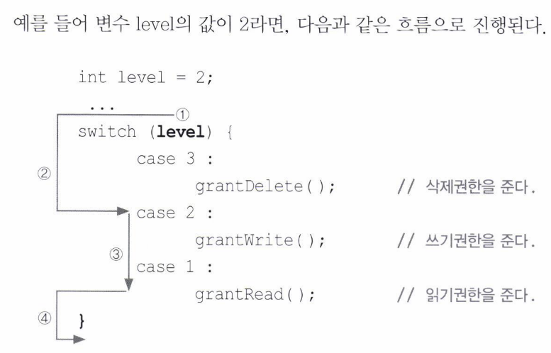

Slide 45
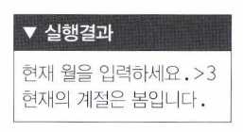

Slide 46
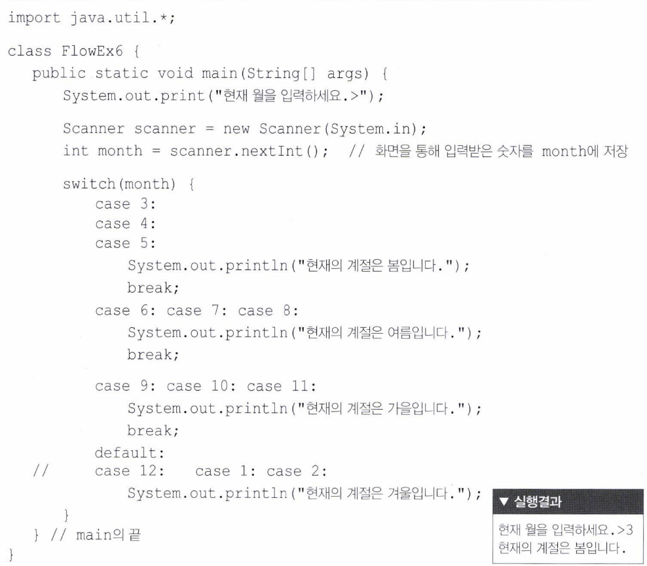

Slide 47
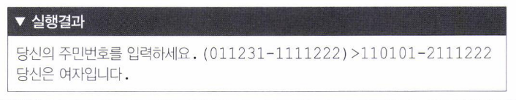
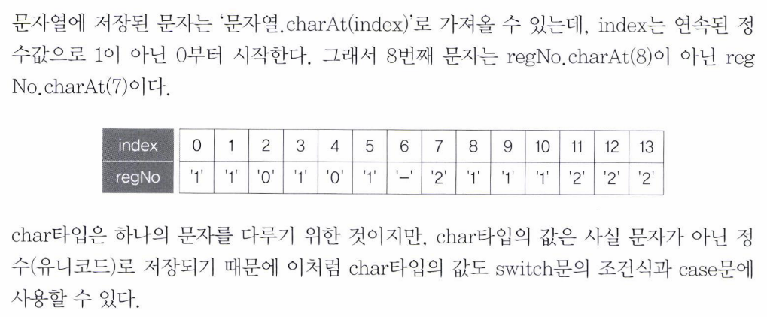

Slide 48
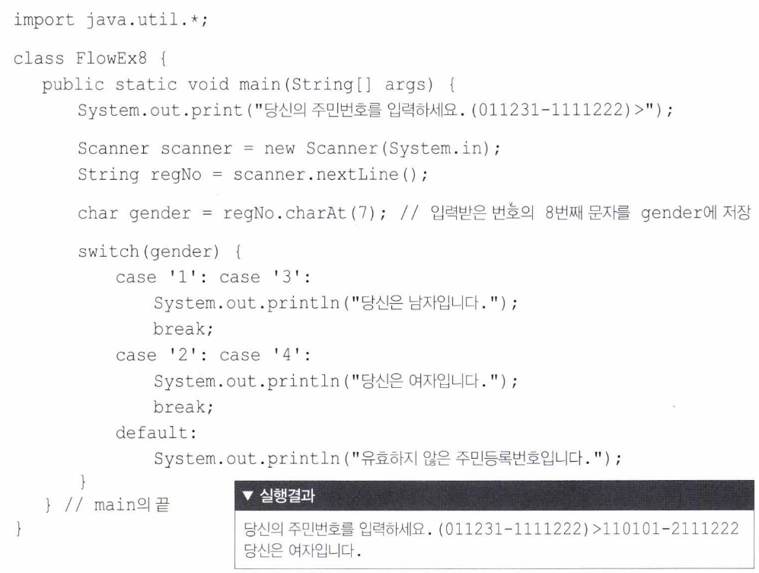

Slide 49
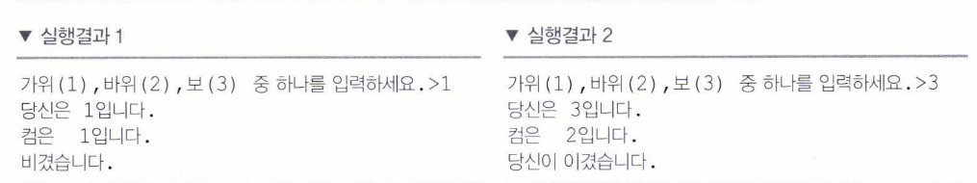
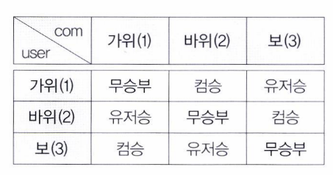


Slide 50


Slide 51


Slide 52




Slide 53



Slide 54


Slide 55

6 For 6.1 For

Slide 56

(start ; stop ; step)

Slide 57


Slide 58



Slide 59



Slide 60



Slide 61


Slide 62


Slide 63



Slide 64



Slide 65


Slide 66


Slide 67


Slide 68


Slide 69
HTML
not yet…

Slide 70


